Slide 1
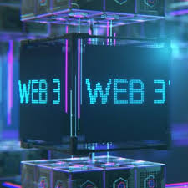
The Rise of Web3: Redefining the Digital Landscape
Web3, the latest evolution of the internet, is ushering in a new era of decentralization, user empowerment, and revolutionary economic models. This transformative shift is poised to reshape how we interact, transact, and engage with the digital world.
BY
R AISHWARYA 22071A67B0
RAHELA SHREEN 22071A67B1

Slide 2
Decentralized Applications: Empowering Users
Blockchain-Powered
User-Controlled
Smart Contracts
Web3 applications are built on blockchain technology, enabling decentralized data storage and processing, secured by cryptography.
Decentralized apps (dApps) give users greater control over their data and digital assets, challenging the traditional centralized model.
Automated, self-executing agreements powered by code, smart contracts underpin the functionality of dApps.

Slide 3
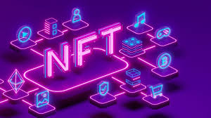
Enhancing User Ownership: New Paradigm in Digital Assets
1
Non-Fungible Tokens (NFTs)
2
User Wallets
Secure, decentralized digital wallets allow users to store, manage, and transact their crypto-based assets and identities.
Unique digital assets that can represent ownership of virtual items, enabling new models of digital scarcity and collectibility.
3
Decentralized Ownership
Web3 empowers users to truly own their digital assets, breaking away from the traditional centralized model.

Slide 4
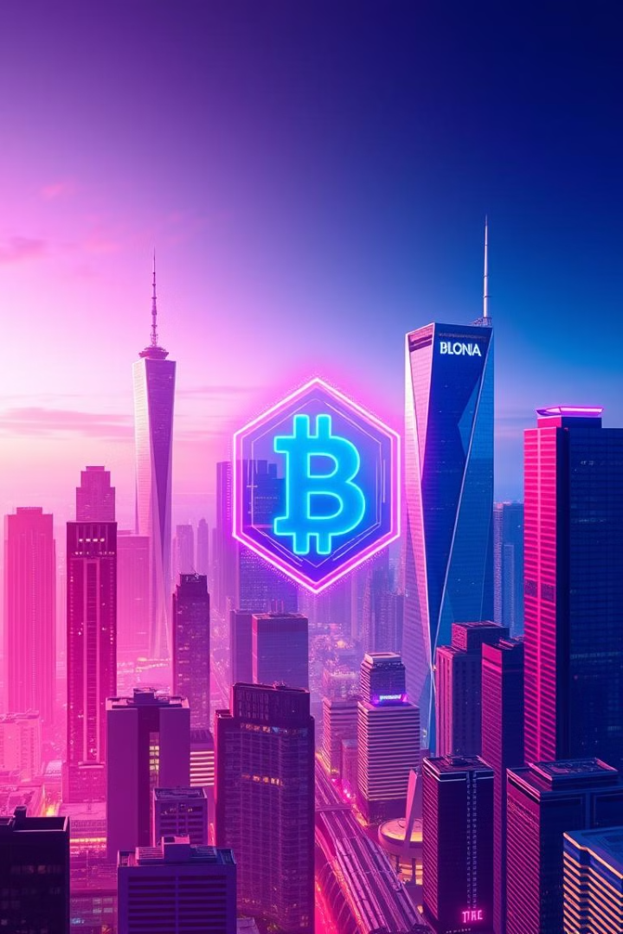
Blockchain and Cryptocurrency: Transforming Economic Models
1
Decentralized Finance
Web3 allows for the creation of decentralized financial services, such as lending, borrowing, and trading, without the need for traditional intermediaries.
2
Tokenization
Assets, both digital and physical, can be represented as tokens on the blockchain, enabling new models of fractionalized ownership and exchange.
3
Novel Economic Incentives
Web3 introduces innovative economic models, such as token-based rewards, staking, and decentralized autonomous organizations (DAOs), empowering new forms of collaboration and value creation.

Slide 5
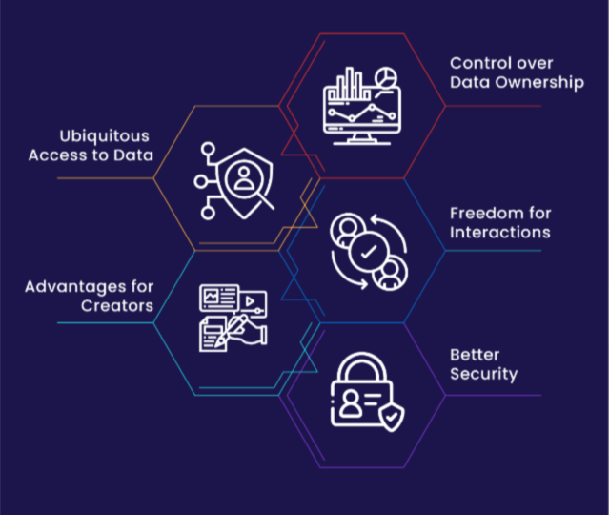
Benefits of Web3: Transparency, Security, and Inclusivity
Transparency
Security
The decentralized nature of Web3 provides increased transparency, as all transactions and data are publicly visible on the blockchain.
Cryptographic security and the distributed nature of blockchain technology enhance the overall security of Web3 applications and ecosystems.
Inclusivity
Web3 empowers individuals and communities, reducing the barriers to financial and digital participation, fostering greater inclusion and accessibility.

Slide 6




Challenges and Considerations: Interoperability, Scalability, and Regulation
Interoperability
Ensuring seamless integration and data exchange between different Web3 platforms and legacy systems remains a key challenge.
Scalability
Developing solutions that can handle the increasing volumes of transactions and data in Web3 environments is crucial for widespread adoption.
Regulatory Clarity
Establishing appropriate regulatory frameworks for Web3 technologies, while balancing innovation and consumer protection, is an ongoing process.

Slide 7
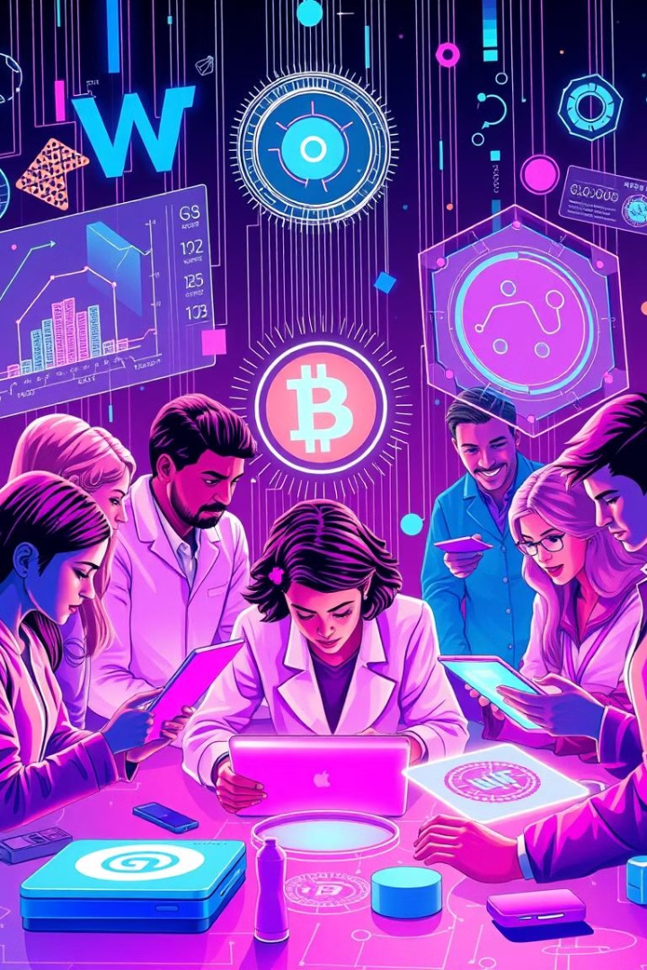



Potential Impact on Industries: Finance, Supply Chain, and beyond
Finance
Decentralized finance (DeFi) is transforming traditional banking and investment models, enabling new financial services and products.
Supply Chain
Web3 technologies can enhance supply chain transparency, traceability, and efficiency, improving trust and collaboration.
Healthcare
Web3 can revolutionize healthcare data management, clinical trials, and patient records, ensuring privacy and secure data sharing.

Slide 8
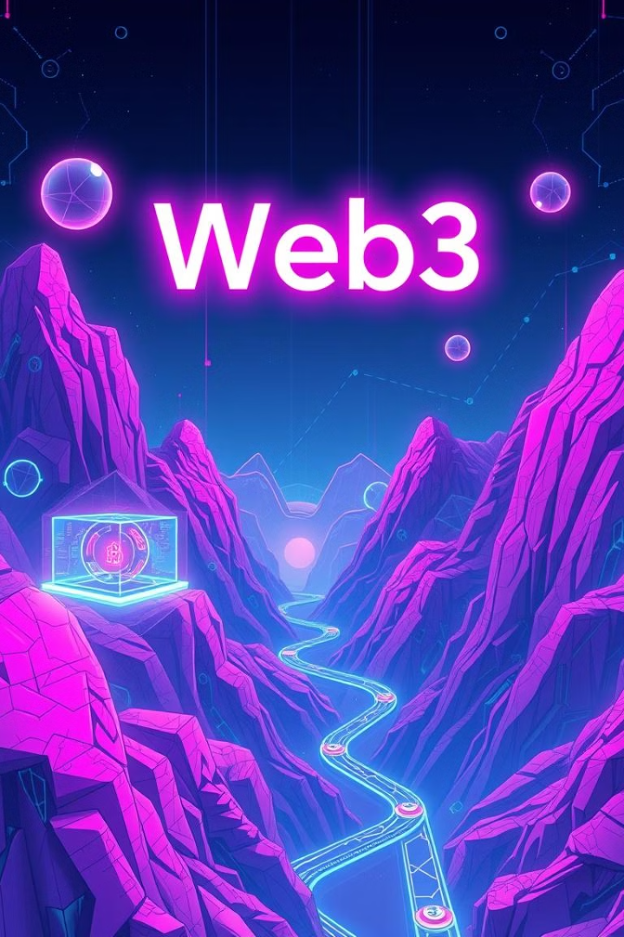
The Future of Web3: Envisioning the Next Phase of the Internet
Metaverse Integration
Web3 technologies will enable more immersive and decentralized virtual experiences, blurring the lines between the physical and digital worlds.
Decentralized Identity
Self-sovereign digital identities, managed by users, will allow for greater privacy and control over personal data.
Decentralized Governance
Decentralized Autonomous Organizations (DAOs) will empower communities to collaboratively manage and govern Web3 ecosystems.

Slide 9
Web3 in Social Media: Redefining Content Creation
Creator Empowerment
Decentralized Moderation
Token-Based Incentives
Web3 social platforms enable creators to directly monetize their content and engage with audiences, reducing the influence of centralized platforms.
Community-driven moderation and governance models in Web3 social apps aim to address issues of censorship and bias.
Rewarding user engagement and content creation with crypto-based tokens introduces new economic models for social media.

Slide 10
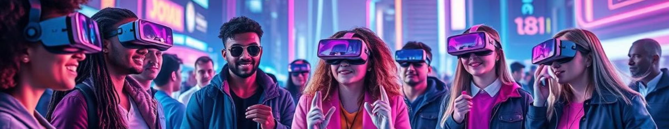
The Rise of Web3: Redefining the Digital Landscape
Web3 is ushering in a new era of decentralization, empowering users, and transforming economic models. As this innovative digital landscape continues to evolve, it holds the potential to disrupt and reshape industries, redefine content creation, and pave the way for a more transparent, secure, and inclusive digital future.

